Slide 1
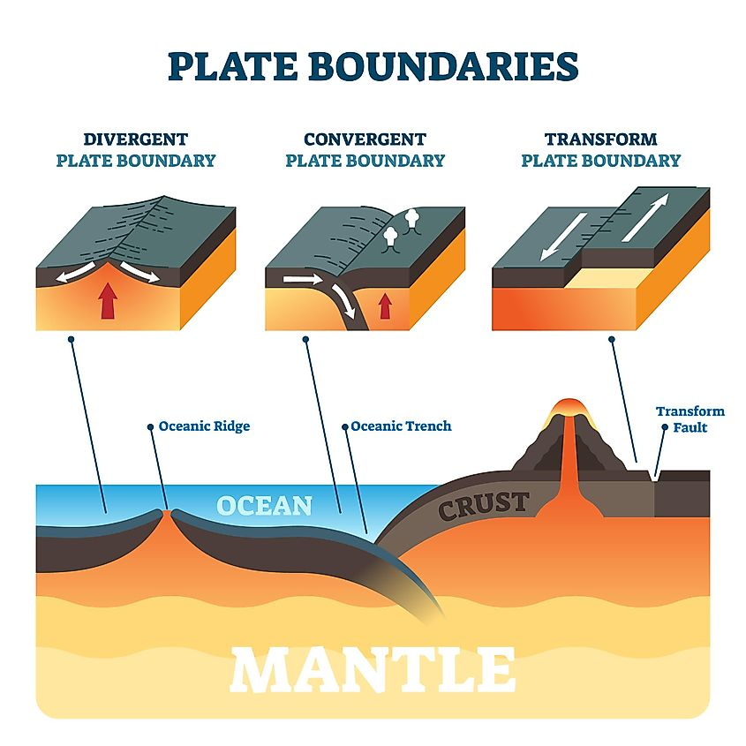
Lesson: Plate Boundaries & Features

Slide 2
ENGAGE

Slide 3
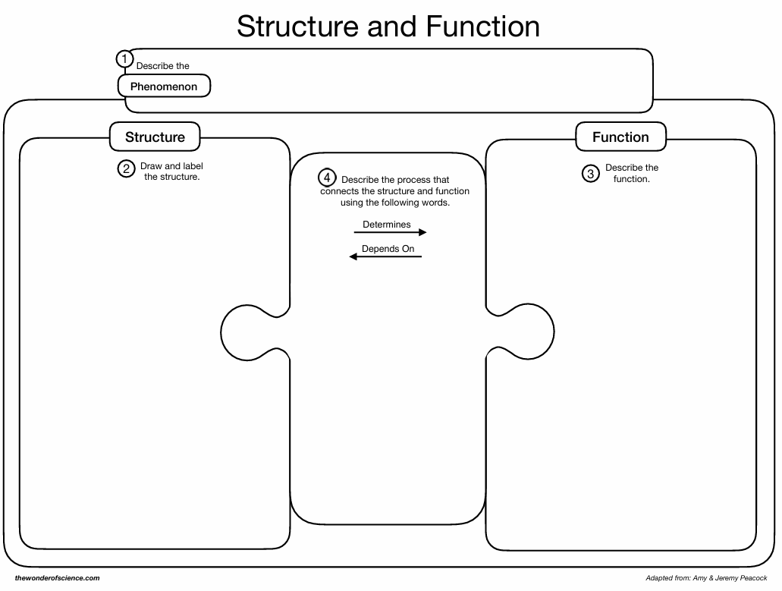
Engage
While viewing the following slides, complete the organizer on how you think these events happen.

Slide 4
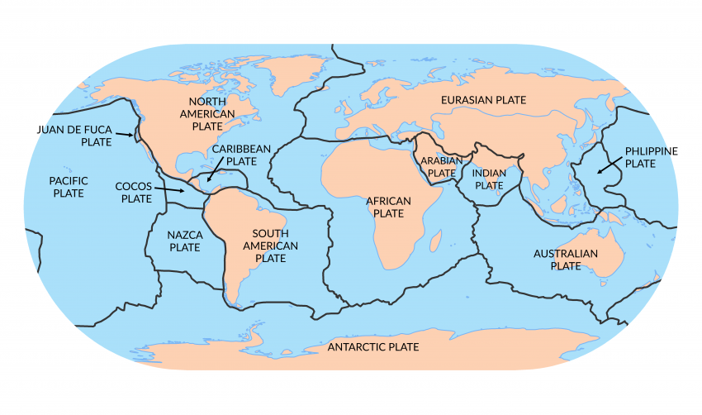
Engage
What geologic features would we find where these plates meet (at their boundaries)?

Slide 5
Engage
Discuss your organizer for one minute with your lab partner.
Be prepared to share out

Slide 6
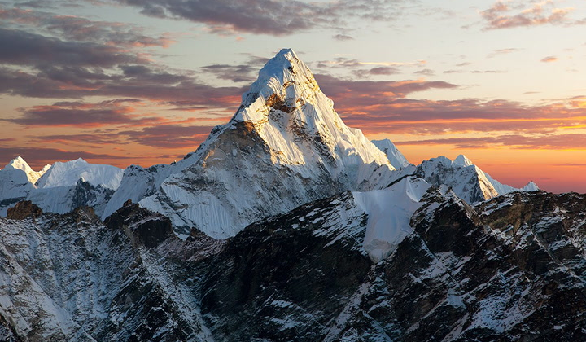
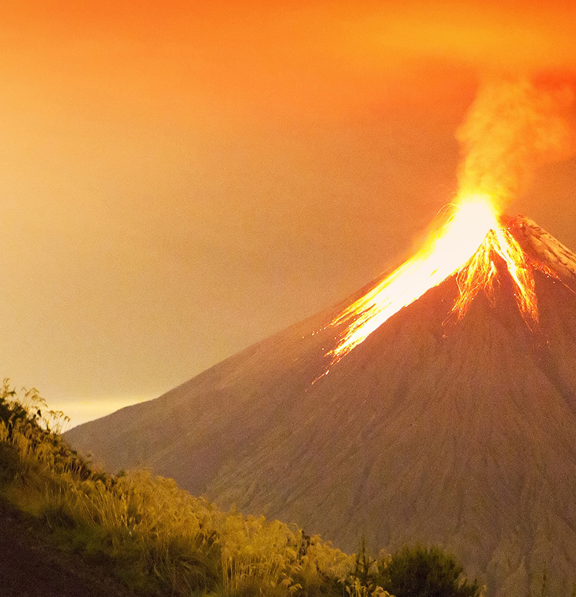
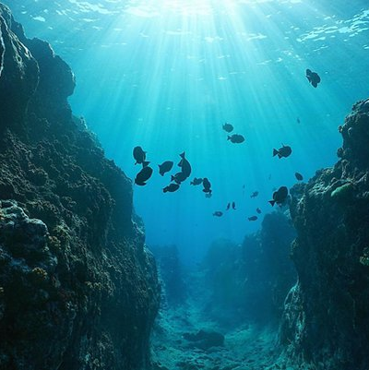
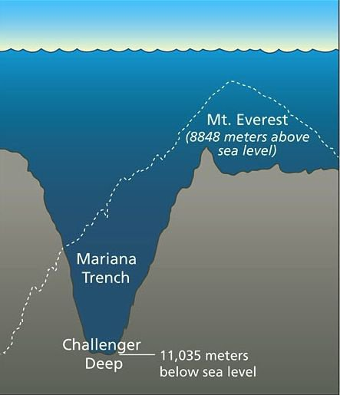
What geologic features would we find where these plates meet (at their boundaries)?

Slide 7
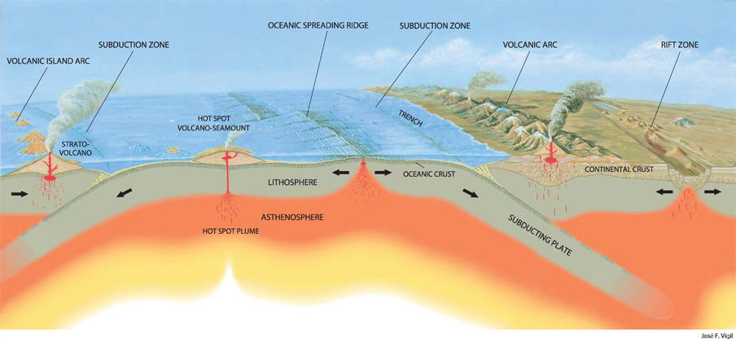
Engage
What three ways can these plates interact with each other?

Slide 8
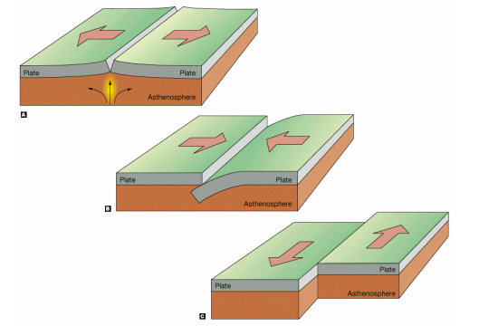
Boundary Types and their features

Slide 9
Explore
Lab: Plate Boundaries

Slide 10
Explain
(I split the boundary types into different colors to differentiate each boundary type & their respective features)

Slide 11
1) What are the different ways plates interact?
1. Divergent plate boundaries: 2 plates are moving away from one another due to rising convection currents
2. Convergent plate boundary: 2 plates are moving towards each other due to sinking convection currents.
3. Transform plate boundary: 2 plates are sliding past one another
See ESRT page 5 – Tectonic Plates for locations of each plate boundary around the world

Slide 12
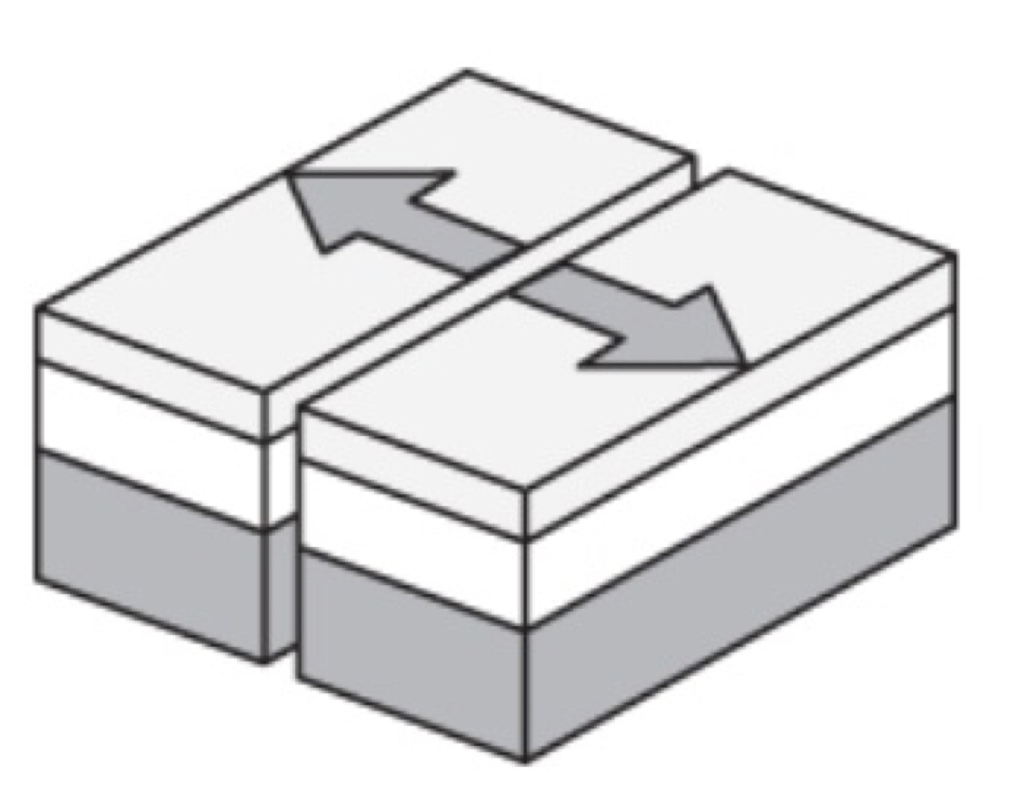
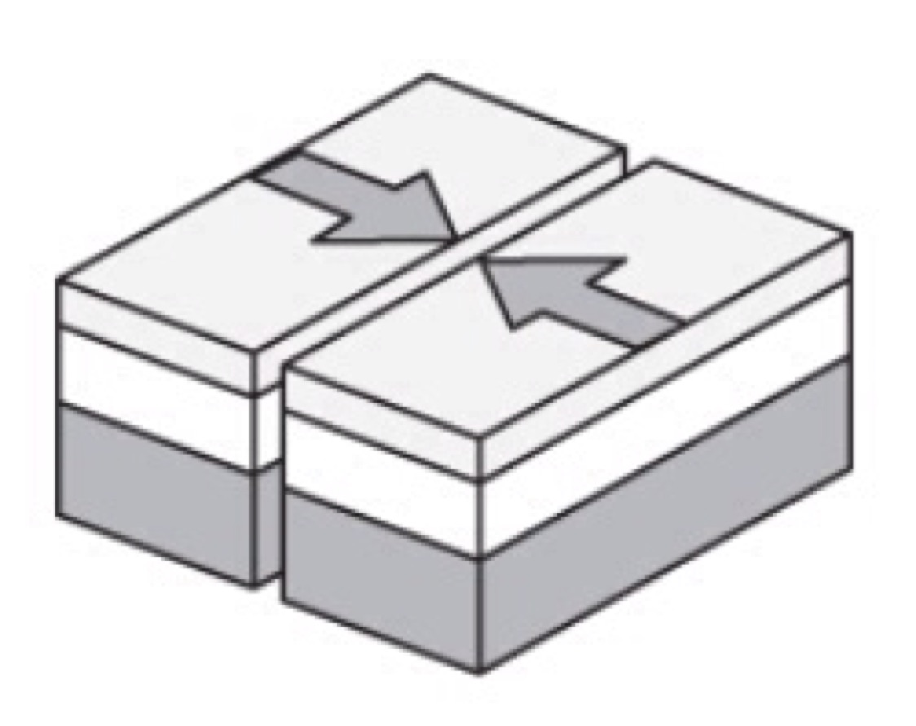
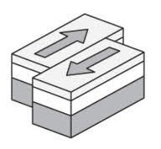
1) What are the different ways plates interact?
1. Divergent plate boundaries:
2. Convergent plate boundary:
3. Transform plate boundary:

Slide 13
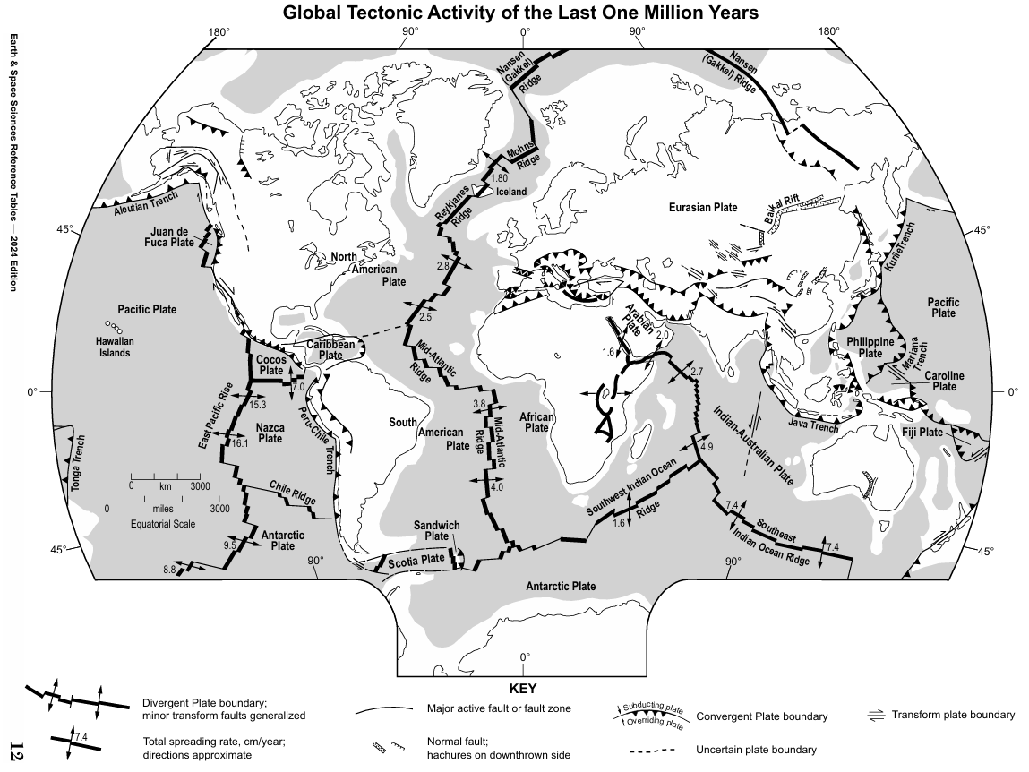

Slide 14
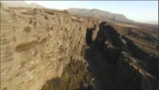
Mid-Atlantic Ridge

Slide 15
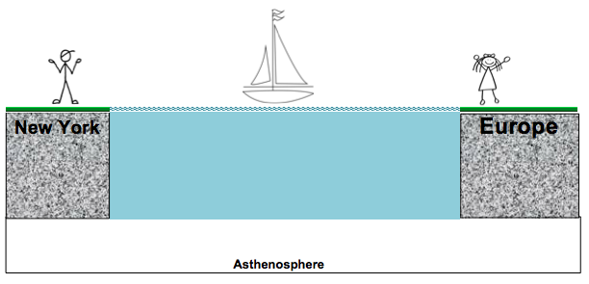
2) What does the bottom of the Atlantic Ocean floor look like?
Making Predictions: The cross section below shows the east coast of North America, the Atlantic Ocean, and the west coast of Europe. Using a pencil, draw what you think the ocean floor looks like as you travel from one continent to the other.
Mid-Ocean Ridge (Volcanic Mountain Range)
Rising magma

Slide 16
Mid-Ocean Ridge (Volcanic Mountain Range)
Rising magma
Explanation:
In the middle of the Atlantic Ocean there is a divergent plate boundary. (See ESRT p5)
At the plate boundary, there is a volcanic mountain range called a mid-ocean ridge.
New seafloor forms here when magma solidifies and causes the seafloor to spread. This means North America and Europe are slowly moving away from each other.

Slide 18
Checkpoint: Use ESRT page 5 to find another example of a mid-ocean ridge. What is the name of this ridge? What are the two plates that are diverging at this ridge?
East Pacific Ridge; Pacific Plate & Antarctic Plate
Southeast Indian Ridge; Indian-Australian Plate & Antarctic Plate

Slide 19
3) How do we know the seafloor is spreading at mid-ocean ridges?
Evidence of seafloor spreading:
Age of bedrock:
Youngest bedrock is at the ridge. This is the hottest crustal location due to rising magma.
Oldest bedrock is at either continent.

Slide 20
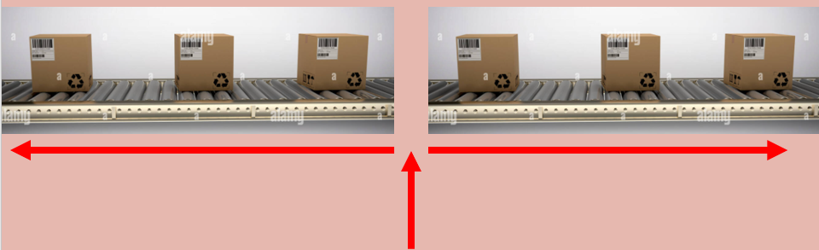

3) How do we know the seafloor is spreading at mid-ocean ridges?
Evidence of seafloor spreading:
Think of a conveyor belt
Oldest
Newest/Youngest
Oldest

Slide 21
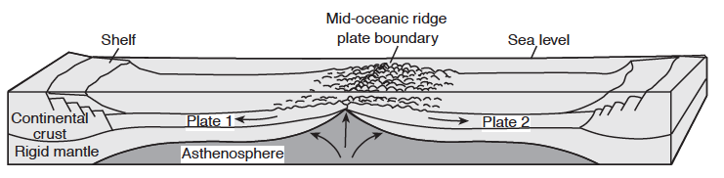
3) How do we know the seafloor is spreading at mid-ocean ridges?
Evidence of seafloor spreading:
Age of bedrock:
Youngest,
Hottest
Oldest
Oldest

Slide 22
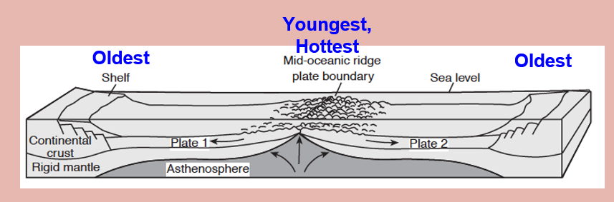


Slide 23

2. Magnetic polarity pattern of bedrock
3) How do we know the seafloor is spreading at mid-ocean ridges?

Slide 24
3) How do we know the seafloor is spreading at mid-ocean ridges?
Evidence of seafloor spreading:
2. Magnetic polarity pattern of bedrock
Earth’s magnetic North Pole is currently near the geographic North Pole. In the past, it seems to have been reversed for periods of time, meaning the magnetic North Pole was located near the geographic South Pole.
As magma cools, magnetic elements like iron in the magma align to the Earth’s magnetic North Pole of the time.
Oceanic crust at equal distances on opposite sides of the ridge have the same magnetic polarity (normal + or reversed -). Meaning, the oceanic crust formed at the same time at the ridge and was pushed apart as new seafloor has been created.

Slide 25
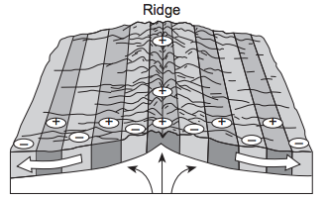
3) How do we know the seafloor is spreading at mid-ocean ridges?
Evidence of seafloor spreading:
2. Magnetic polarity pattern of bedrock
Magnetic polarity pattern is a mirror image on opposite sides of the ridge.

Slide 26
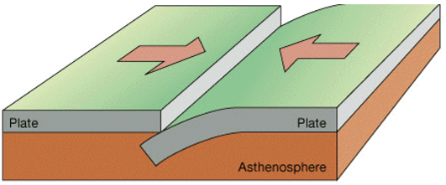
Convergent Plate Boundaries

Slide 27
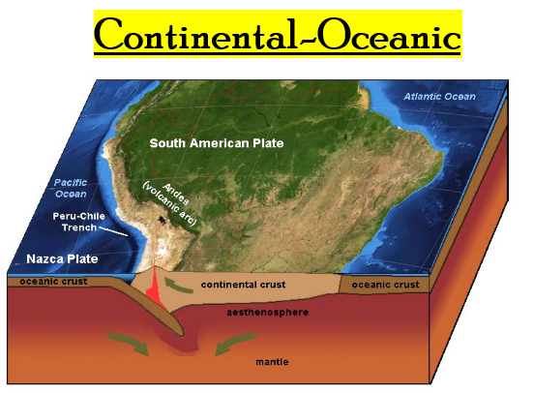
Convergent Plate Boundaries

Slide 28
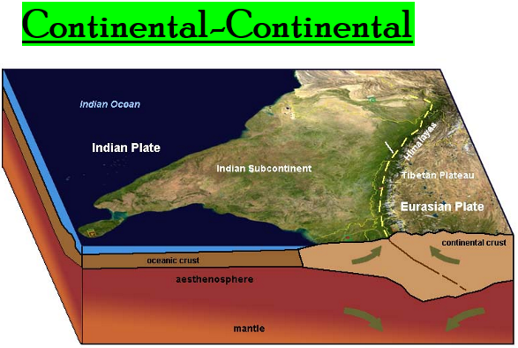
Convergent Plate Boundaries

Slide 29
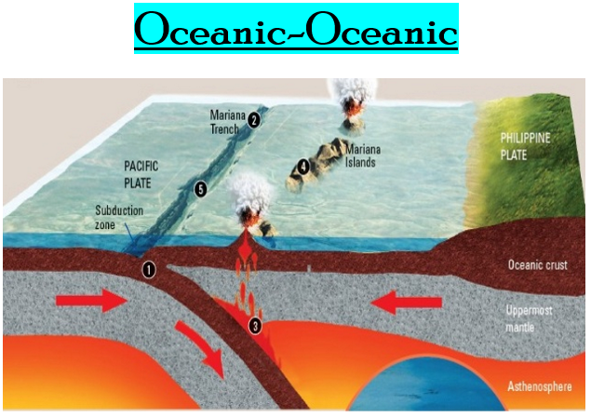
Convergent Plate Boundaries

Slide 30
4) What geologic features occur when a continental plate collides with an oceanic plate?
Making predictions – Convergent Plate Boundaries: On the diagram below…
1. Label each type of crust.
2. Label the density of each type of crust.
3. Using a pencil, draw what you think will happen when these two plates collide.

Slide 31
Convergent Plate Boundaries

Slide 32
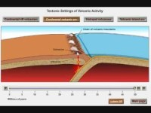
Continental-Oceanic Convergent Plate Boundaries
0:00 - 0:32

Slide 33
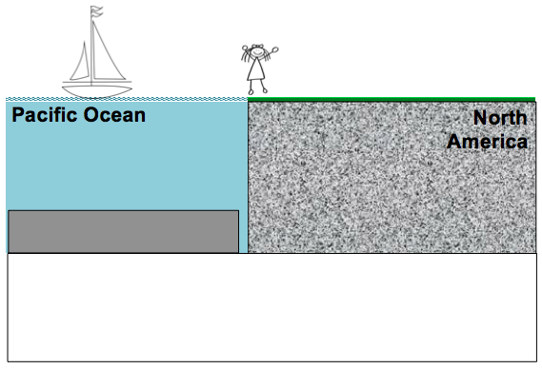
Making predictions – Convergent Plate Boundaries: On the diagram below… 1. Label each type of crust. 2. Label the density of each type of crust. 3. Using a pencil, draw what you think will happen when these two plates collide.
Volcanic Mountain Range
Magma Chamber
(Cascade Mountains in North America)
Ocean Trench
Continental Crust
2.7 g/cm³
Oceanic Crust
3.0 g/cm³
X
X
X
Deep Earthquakes
Asthenosphere

Slide 34
Volcanic Mountain Range
Magma Chamber
(Cascade Mountains in North America)
Ocean Trench
Continental Crust
2.7 g/cm³
Oceanic Crust
3.0 g/cm³
X
X
X
Deep Earthquakes
Asthenosphere
Explanation:
Continental-Oceanic Convergent Boundary: This is called a subduction zone caused by the collision of an oceanic and continental plate

Slide 35
Volcanic Mountain Range
Magma Chamber
(Cascade Mountains in North America)
Ocean Trench
Continental Crust
2.7 g/cm³
Oceanic Crust
3.0 g/cm³
X
X
X
Deep Earthquakes
Asthenosphere
Explanation:
Because the oceanic crust is more dense, it will always subduct (move under) the less dense continental crust which destroys crust, causes deep earthquakes, forms ocean trenches, and forms continental volcanic mountains.

Slide 36
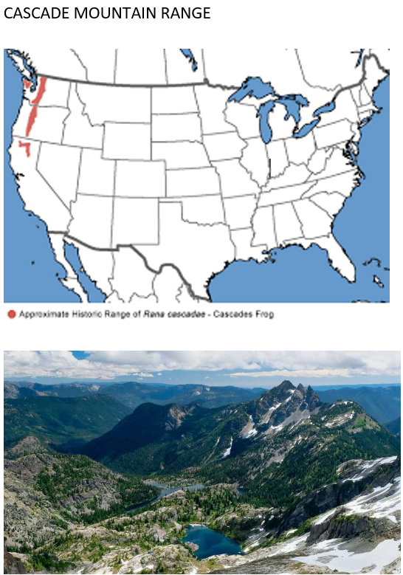
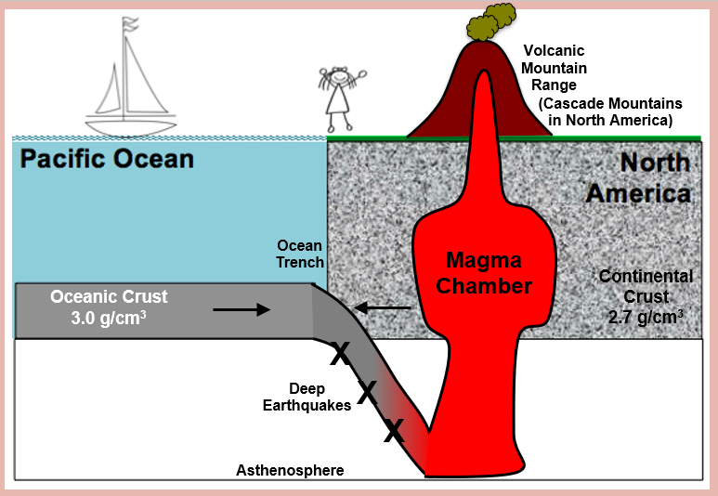

Slide 37
Checkpoint – Continental-Oceanic Convergent Boundaries:
1. Use ESRT page 5 to find the continental-oceanic plate boundary on the west coast of South America. Which two plates are converging at this boundary? What is the name of the trench formed at this boundary?
South American Plate & Nazca Plate; Peru-Chile Trench

Slide 38
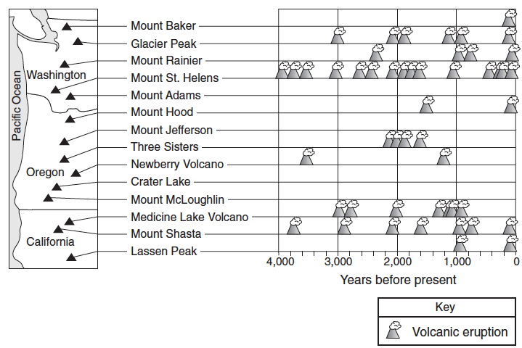
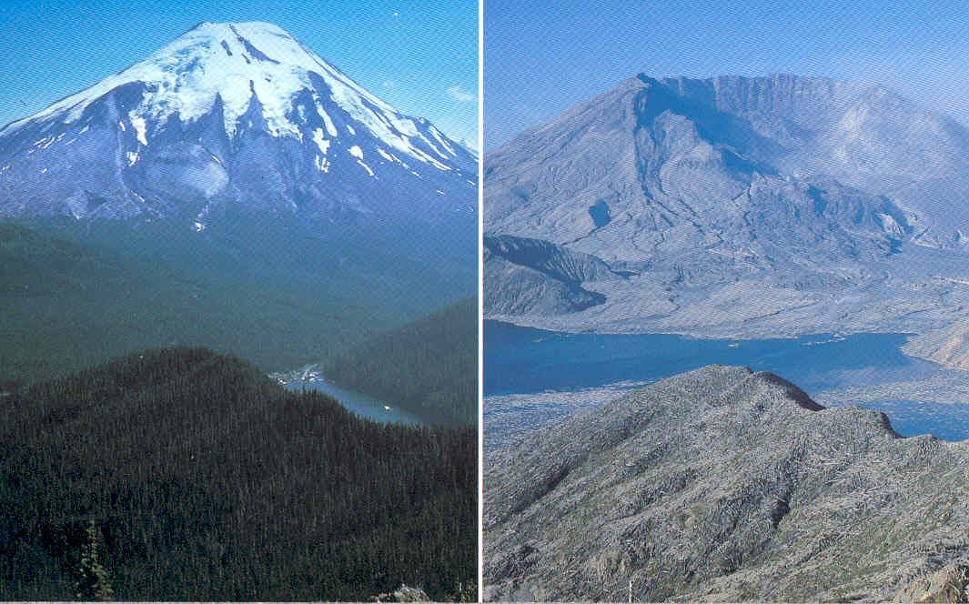
Checkpoint – Continental-Oceanic Convergent Boundaries:
Base your answers to questions 2 through 5 on the map below which shows locations of the volcanic peaks of the Cascade Mountain Range of the northwestern United States. The table shows the major eruptions of each peak over the past 4,000 years.
2. Which volcano of the Cascade Mountain Range has erupted most frequently in the past 4,000 years?
Mount St. Helens

Slide 39
Checkpoint – Continental-Oceanic Convergent Boundaries:
Base your answers to questions 2 through 5 on the map below which shows locations of the volcanic peaks of the Cascade Mountain Range of the northwestern United States. The table shows the major eruptions of each peak over the past 4,000 years.
3. What type of plate boundary formed the Cascade volcanic mountains?
Convergent

Slide 40
Checkpoint – Continental-Oceanic Convergent Boundaries:
Base your answers to questions 2 through 5 on the map below which shows locations of the volcanic peaks of the Cascade Mountain Range of the northwestern United States. The table shows the major eruptions of each peak over the past 4,000 years.
4. What are the names of the two plates found on either side of this plate boundary?
North American Plate & Juan de Fuca Plate

Slide 41
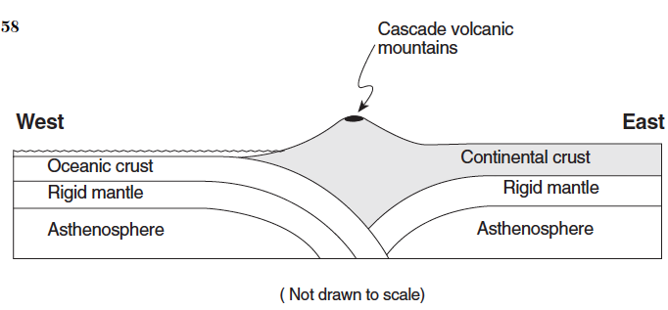
Checkpoint – Continental-Oceanic Convergent Boundaries:
Base your answers to questions 2 through 5 on the map below which shows locations of the volcanic peaks of the Cascade Mountain Range of the northwestern United States. The table shows the major eruptions of each peak over the past 4,000 years.
5. On the cross section below, place an arrow in the continental crust and an arrow in the oceanic crust to show the relative directions of plate movement.

Slide 42
Convergent Plate Boundaries

Slide 43
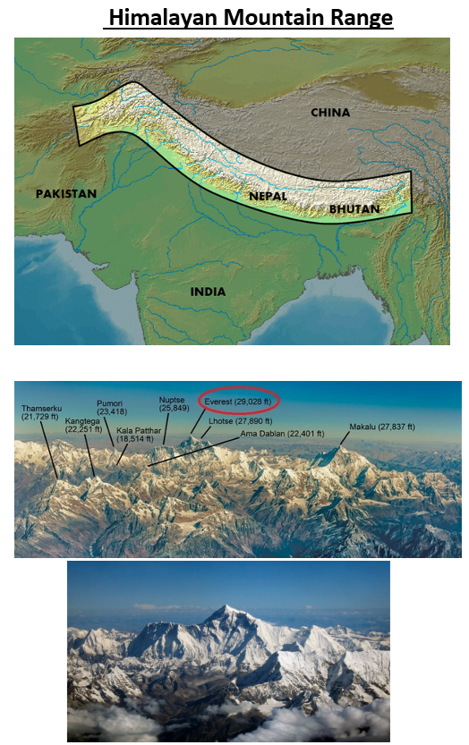
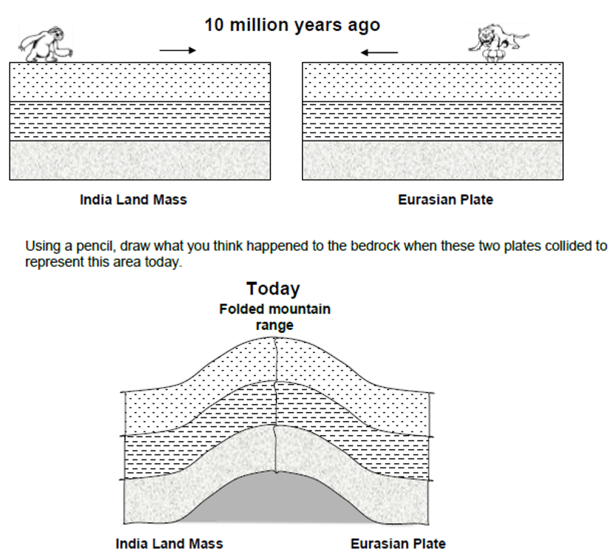
How did the Himalayas form?

Slide 44
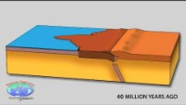
Indian Plate & Eurasian Plate = Himalayas

Slide 45
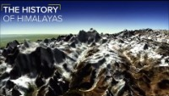
Indian Plate & Eurasian Plate = Himalayas

Slide 46
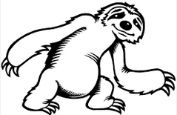


5) What geologic features occur when two continental plates collide?
Making Predictions – Convergent Plate Boundaries #2: The diagram below represents the bedrock of the India landmass moving towards the bedrock Eurasian Plate 10 million years ago.
10 million years ago
India Land Mass Eurasian Plate
Using a pencil, draw what you think happened to the bedrock when these two plates collided to represent this area today.

Slide 47

5) What geologic features occur when two continental plates collide?
Today
Folded mountain range
India Land Mass Eurasian Plate
Explanation:
Continental-Continental Convergent Boundary: The collision of two continental plates forms folded mountain ranges, such as the Himalayan Mountains between the India land mass and the Eurasian Plate shown above.

Slide 48
Convergent Plate Boundaries

Slide 49
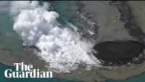
New Island forming off Japan (11/10/23) (Oceanic & Oceanic Convergent Plate Boundary)

Slide 50
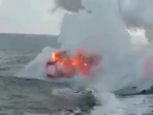
Volcanic Island Formation

Slide 51
Oceanic-Oceanic Convergent Plate Boundaries
0:33 – 1:28

Slide 52
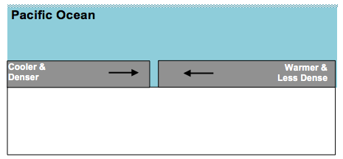
6) What geologic features occur when two oceanic plates collide?
Making Predictions – Convergent Plate Boundaries #3: On the diagram below, use a pencil to draw what you think will happen when these two plates collide. The oceanic plate on the left is cooler and denser than the oceanic plate on the right.
Magma Chamber
Volcanic Island Arc
Ocean Trench
Asthenosphere

Slide 53
Magma Chamber
Volcanic Island Arc
Ocean Trench
Asthenosphere
Explanation:
Oceanic-Oceanic Convergent Boundary: The collision of two oceanic plates form deep ocean trenches and island arcs.
Commonly known island arcs include the islands of Japan and the Aleutian Islands off the coast of Alaska.

Slide 54
Checkpoint – Oceanic-Oceanic Convergent Boundaries: Use ESRT page 5 to find two ocean trenches formed by an oceanic-oceanic convergence.
Aleutian Trench
Mariana Trench

Slide 55
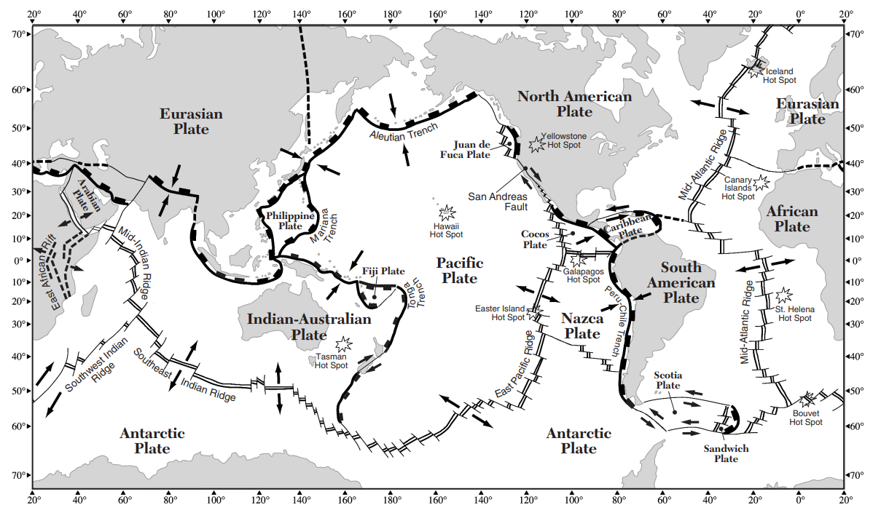
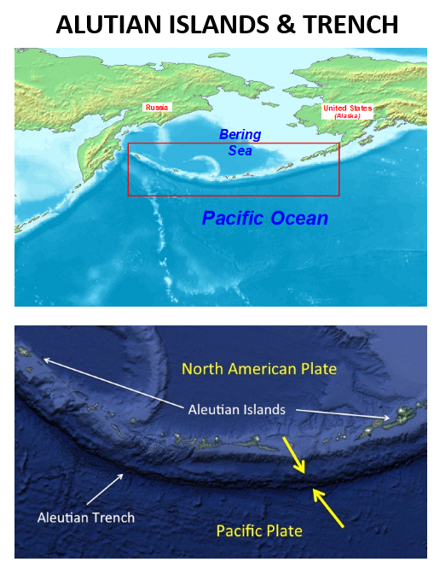

Slide 56
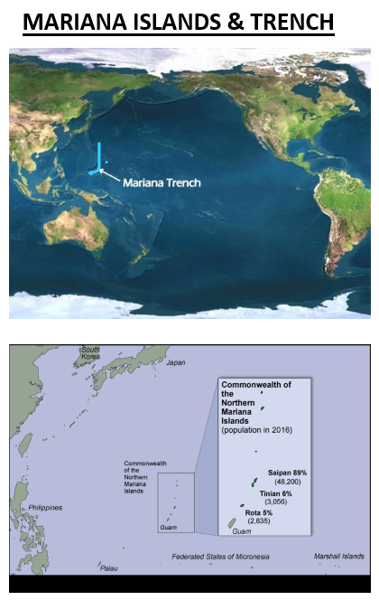

Slide 57
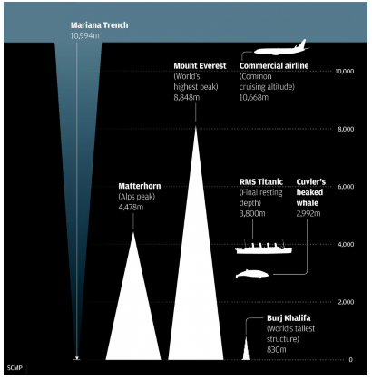

Slide 58
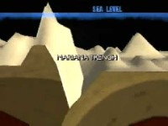
Mariana Trench

Slide 59
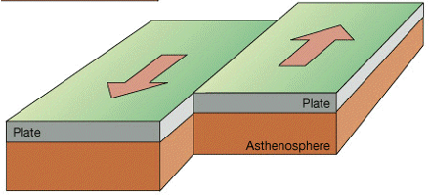
Transform Plate Boundary

Slide 60
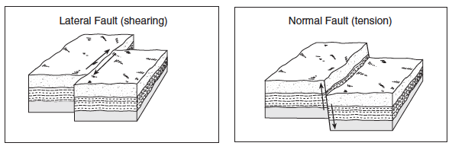
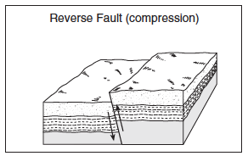
7) What geologic features form at a transform boundary?
Transform boundary: one plate slides past another plate causing shallow earthquakes

Slide 61
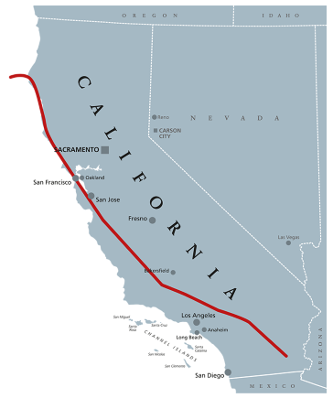
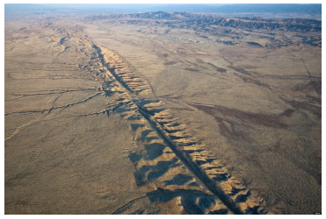
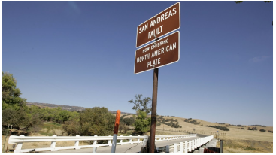

Slide 62
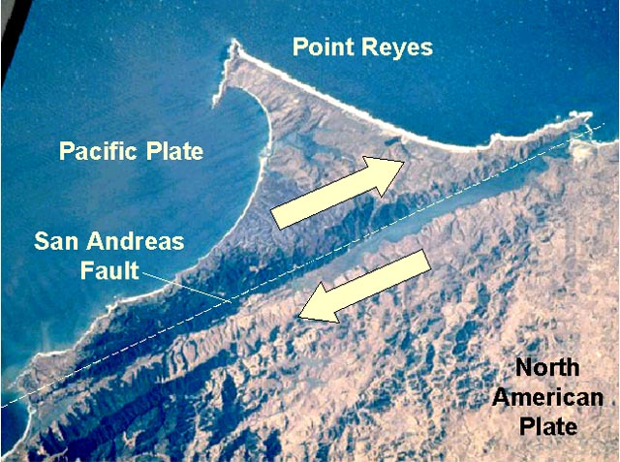

Slide 63

San Andreas Fault

Slide 64

San Andreas Fault

Slide 65
Checkpoint – Transform Boundaries: Using ESRT page 5, find the transform boundary located in the continental United States. What is the name of this boundary? Which two plates are sliding past each other at this boundary?
San Andreas Fault;
North American Plate & Pacific Plate

Slide 66
Checkpoint – Plate Boundaries: Use your knowledge of Earth Science and the Earth Science Reference Tables to answer the questions below.
1. The movement of tectonic plates is inferred by many scientists to be driven by
a. tidal motions in the hydrosphere
b. density differences in the troposphere
c. convection currents in the asthenosphere
d. solidification in the lithosphere

Slide 67

Checkpoint – Plate Boundaries
2. The diagram below shows some features of Earth’s crust and upper mantle.

Slide 68

Checkpoint – Plate Boundaries
Which model most accurately shows the movements (arrows) associated with the surface features shown in the diagram?

Slide 69
Checkpoint – Plate Boundaries
3. According to tectonic plate maps, New York State is presently located
a. at a convergent plate boundary
b. above a mantle hot spot
c. above a mid-ocean ridge
d. near the center of a large plate

Slide 70
Checkpoint – Plate Boundaries
4. Which coastal area is most likely to experience a severe earthquake?
a. east coast of North America
b. east coast of Australia
c. west coast of Africa
d. west coast of South America

Slide 71

Checkpoint – Plate Boundaries
5. The map below shows the northern section of the boundary between the Arabian Plate and the African Plate. Arrows show the relative direction of plate motion.
Which type of plate boundary is located at the Jordan Fault?
a. divergent c. transform
b. convergent d. complex

Slide 72
Checkpoint – Plate Boundaries
6. Which of the following locations is the site of a convergent plate boundary?
a. the Mid-Atlantic ridge
b. the Aleutian trench
c. the Atlantic-Indian ridge
d. the Pacific/North American plate boundary

Slide 73
Checkpoint – Plate Boundaries
7. Which tectonic feature is associated with a complex or uncertain plate boundary?
a. Southwest Indian Ridge c. Mariana Trench
b. East African Rift d. Galapagos Hot Spot

Slide 74

Checkpoint – Plate Boundaries
Base your answers to questions 8 and 9 on the block diagram below which shows the boundary between two tectonic plates.
8. Which type of plate boundary is shown?
a. divergent c. transform
b. convergent d. complex

Slide 75
Checkpoint – Plate Boundaries
Base your answers to questions 8 and 9 on the block diagram below which shows the boundary between two tectonic plates.
9. Which tectonic plate boundary is best represented by this diagram?
a. Nazca Plate and Pacific Plate boundary
b. Scotia Plate and South American Plate boundary
c. Juan de Fuca Plate and North American Plate boundary
d. Antarctic Plate and Indian-Australian Plate boundary

Slide 76

Checkpoint – Plate Boundaries
Base your answer to questions 10 through 12 on the cross section below, which shows the major surface features of Earth along 25° S latitude between 75° W and 15° E longitude. Points A, B, and C represent locations on Earths crust.
10. Identify the crustal feature located at point A.
Trench; subduction zone; convergent boundary

Slide 77
Checkpoint – Plate Boundaries
Base your answer to questions 10 through 12 on the cross section below, which shows the major surface features of Earth along 25° S latitude between 75° W and 15° E longitude. Points A, B, and C represent locations on Earths crust.
11. Identify the tectonic plate motion that is causing an increase in the distance between South America and Africa.
Divergence; seafloor spreading

Slide 78

Checkpoint – Plate Boundaries
Base your answer to questions 10 through 12 on the cross section below, which shows the major surface features of Earth along 25° S latitude between 75° W and 15° E longitude. Points A, B, and C represent locations on Earths crust.
12. Bedrock samples were taken at the mid-ocean ridge and points B and C. On the grid, draw a line to show the relative age of the bedrock samples between these locations.

Slide 79

Checkpoint – Plate Boundaries
13. The cross section below represents a pattern of magnetic field reversals preserved in the igneous bedrock of the oceanic crust east of the Mid-Atlantic ridge.
Complete the diagram above by shading the pattern of normal polarity on the west side of the ridge center. Assume the rate of plate movement was constant on both sides of the ridge center. Your answer must show the correct width and placement of each normal polarity section.

Slide 80
Elaborate

Slide 81
Boundary Types & Features

Slide 82
Evaluate
Quiz/test or similar

